Slide 1
Gittin’ * DONE
a guide to using Git and GitHub for collaborative data science
by Matt Tranquada

Slide 2
Outline
(Re)Understanding Git
Git Workflow Patterns
Advanced Git and GitHub Practices
GitHub Tips for Data Science
Links and Resources
Git Command Reference

Slide 3
1. (RE)Understanding Git
A Deep dive

Slide 4
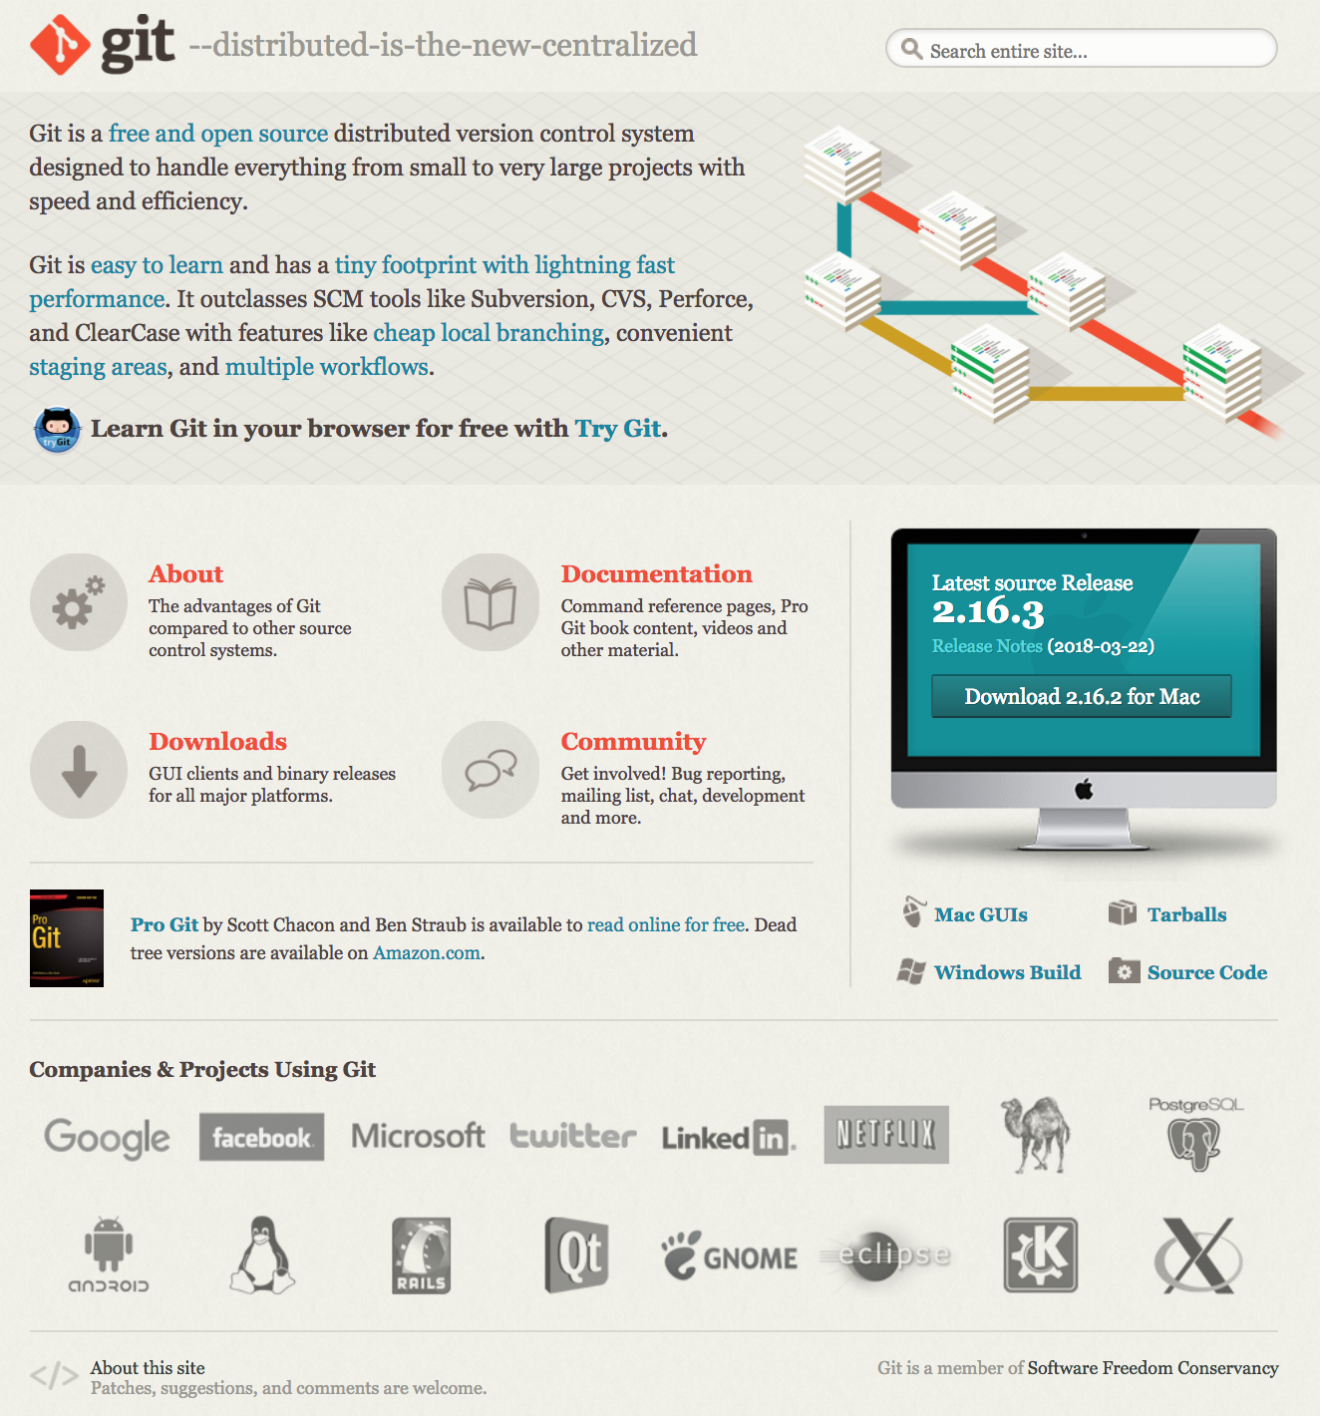
What is git?
Git is a version control system (VCS) for source code management (SCM)
The development of Git was started by Linus Torvalds after the relationship between the Linux community and BitKeeper, their VCS vendor, brokedown and it was first released in 2005
Git is a distributed version control system (DVCS) designed to scale for large and complex projects, in contrast to a centralized version control system (CVCS)
The Git-SCM homepage

Slide 5
WHAT IS SPECIAL ABOUT GIT?
Seeing the problems with existing VCS/SCM solutions available, Torvalds and company focused on a few key objectives in designing Git:
Speed – most operations in Git are performed locally and scale well with data size and complexity
Simple design – designed to be easy to adapt for a wide range of uses
Strong support for non-linear development – can support thousands of parallel development branches
Fully distributed – remote and local repositories are functionally the same, eliminating the single point of failure often found in CVCSs
Can handle large projects efficiently – designed to handle projects like linux kernel development with millions of files while maintaining speed and data integrity

Slide 6
Keys to understanding git
Git was developed as a response to all the problems Linus Torvalds saw with previous VCS and SCM systems
If you know anything about Linus Torvalds, you know he is not shy about having opinions
Although the high-level design of Git is designed to be easy to use, Git is built on top of a very sophisticated set of low-level filesystem-like tools
These are often referred to as “porcelain” (high-level) vs. “plumbing” (low-level) functions
If you get stuck, there are a lot of guides and tutorials

Slide 7
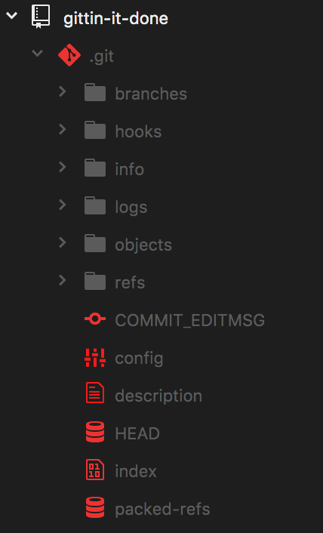
How does git actually work?
When you clone or initialize a Git repository in a directory, it actually creates a new “.git” subdirectory within the folder that stores the repo’s database
To inspect the .git directory, you can check it out on the command line or, like I do here, use a text editor like Atom to navigate it
Documents are stored as blob objects within a database and referred to by snapshots that capture the history of the project and the relationship and state of those objects along with commit messages from the contributors involved
The .git subdirectory as it appears in Atom

Slide 8
ANATOMY OF A GIT
Important Git files in the root directory:
config : Contains configuration settings for the repo, such as core settings and where remotes live.
FETCH_HEAD : Contains the hashes for branch/remote heads updated during the last git fetch.
HEAD : The current reference (“ref”) you’re looking at. (Typically the same as refs/heads/master).
index : Stores the staging area information for file edits, which includes metadata such as timestamps, file names, and hashes for files already tracked by Git.
Other Git files in the root directory:
COMMIT_EDITMSG : The message form the last commit. (Not actually used by Git!)
description : Descriptive info on repo (only used by GitWeb or git instaweb)
packed-refs : File used for storing dormant refs (/refs directory contains the actual references).
ORIG_HEAD : When doing a merge, this is the hash of the branch you’re merging into.
MERGE_HEAD : When doing a merge, this is the hash of the branch you’re merging from.
MERGE_MODE : Tracks constraints originally passed from git merge to pass to git commit in the event of a conflict.
MERGE_MSG : Lists conflicts that happen during your current merge.
RENAMED-REF : Not much documentation, but seems to be an error file related to refs.

Slide 9
ANATOMY OF A GIT
Git Directories:
branches : Directory containing information on project branches
hooks : Directory containing scripts executed at certain times when working with Git, such as after a commit.
info : Contains the exclude file, which can be used as a project-level file blacklist similar to .gitignore files
logs : Contains the history for different project branches.
objects : Git’s internal storage for blob data, with objects indexed by hash
rebase-apply : Directory used for rebasing and the git am command.
refs : Master copy of all refs that live in your repository including refs for stashes

Slide 10
Git CONCEPTS: BLOBS, Hashes, and Trees
At the core of Git is a key-value data store that allows you to put any kind of content into Git and get back a unique key to retrieve that content again
It may help to think of this like a coat check – each object that goes into the data store gets a unique ticket to pick it up, but there is no distinction about the kind of coat, the owner, etc.
Every time an object is added to the Git object data store it generates a 40-character checksum hash of the content you store (plus a header) called the SHA-1 hash
The first 2 characters of the hash will be used to name a subdirectory in the /objects folder, and the other 38 characters are used to name the blob file within
A blob is a kind of data object that only contains content without any filename
To track the filenames and relationships between files, Git has a second kind of object called a tree – each tree contains one or more tree entries containing an SHA-1 + mode, type, and filename
Blobs in a Tree

Slide 11
Git CONCEPTS: BLOBS, Hashes, and Trees
Shortened SHA-1 hash pointer
Filename
Example Description
A simple Git Tree diagram

Slide 12
GIT CONCEPTS: Three States, three Sections
Git has three main states that your files can be in:
Modified : A file has been changed, but those changes have not yet been recorded in the local database.
Staged : A modified file, in its current version, has been marked for inclusion in the next commit “snapshot”.
Committed : The data from a file has been safely stored in the local database.
These three states align with the three main sections of a Git project:
Working Directory : A single ”checkout” of one version of the project that is decompressed from the Git database and placed on disk.
Staging Area [index] : The place where
Repository [.git directory] : The place where Git stores the (zlib compressed) object database and metadata for the project. Copied when you use git clone
The three sections of the Git framework, which (from left) match the “Modified”, “Staged”, and “Committed” states

Slide 13
GIT CONCEPTS: SNAPSHOTS
Delta-Based version control
Snapshot-based version control
Records all changes as diffs/deltas relative to the original file
Only keeps track of file changes; no new data added to database if there are no changes
Space efficient to store new data, but may be difficult to recover an exact arbitrary state
Records each commit like a “snapshot of a miniature filesystem”
Each snapshot is actually a tree object!
Objects are stored using delta compression (zlib) to save space

Slide 14
GIT CONCEPTS: COMMITS
Git has a third kind of object: the commit
The structure of a commit is simple and contains:
The top-level tree for the snapshot of the project at the current point
The author and committer information
user.name
user.email
timestamp
A blank line
The commit message
Each commit references the previous commit, creating a cascading history of changes
A diagram of a single Commit

Slide 15
Blob
Commit
Tree

Slide 16
A simple graph diagram unpacking the Commit pointers in a small repository with three Commits

Slide 17
When you run git add and git commit You are
Storing blob objects for the files that have changed
Updating the index file
Writing out the snapshots as tree objects
Writing a commit that references the top-level tree object and the previous commit object

Slide 18
Git Concepts: References, branches and Heads
Instead of forcing you to remember SHA-1 hashes for each object, Git stores hashes your are tracking as references in the /refs folder
Branches in Git are simply references to different commit objects within the repository database, and the current state of each branch is tracked by a head reference
Git knows which branch you’re on by tracking the reference to your last commit in the HEAD file located in the root .git directory
An update of the example repository diagram showing the Heads of two Branches: Master and Test

Slide 19
Unpacking: initializing Git
git init
git add .
git commit
Creates a new .git subdirectory within the current directory
Adds all the files in the current directory as blob and tree objects into the .git data store
Creates a new commit object wrapping the tree and blob objects and sets the project HEAD to point to that commit reference

Slide 20
Git CONCEPTS: Tags and Remotes
Git has one more kind of object: the tag.
Tag objects are like a commit object (they contain a tagger, a timestamp, a message, and a pointer) but a tag points to a commit instead of a tree.
The tag is basically a branch reference that never moves, it just points to a specific commit and gives it a friendlier name
Lightweight tags are just stored as references, but annotated tags are full-fledged objects
There is also a third kind of reference: the remote reference.
Remote references are created to store the state of a remote repository the last time you pushed files to it
Remote references are like branch references except they are considered read-only; you can checkout from a remote ref but Git won’t point the HEAD file at it because it is only a bookmark storing the last known state and you can’t commit directly to it

Slide 21
GIT CONCEPTS: Local and Remote Repositories
Git has a special set of transfer protocols to move data between local and remote repositories
Remember, the Git model is fully-distributed, so all copies of a project repository are functionally equal except for the state – if the repo on GitHub is lost, any developer’s local repo can be used to rebuild the project
When uploading and downloading files between local and remote repositories, Git quickly compares the files on each side and sends a compressed packfile of any objects that differ based on the operation
git fetch downloads data and git push uploads data
git pull actually fetches the remote data when called, and then merges the remote branch into the current working branch, provided you are tracking a remote branch
git clone automatically fetches data from a remote repo and syncs the local master branch to track the remote master branch

Slide 22
Unpacking: Cloning and editing a GitHub Repo
git clone
git add .
git commit
git push origin master
Git uses fetch to grab a copy of the GitHub repo, unpacks a copy of the working directory based on the origin master head state, and updates the local master HEAD to point to the same commit
Git stages your local changes
Git commits your changes to your local repo
Git compares the local and remote repo states and then decides a) what files are different and b) are there any conflicts based on the head state of the current branch

Slide 23
Git CONCEPTS: MERGING BRANCHES
Git has

Slide 24
UNPACKING: The PULL AND PUSH
git pull origin master
git add .
Git uses fetch to return the current state of the remote origin master repo, then merges it with the current state of the local working directory (i.e. the local master branch)
Git restages your changes based on the merged commits, trees, and blobs
Git writes a commit referencing the previous (new) merge commit
Git repushes your changes to the remote repo, which now has a common commit reference to merge the data with respect to

Slide 25
Customizing git: GUI options

Slide 26
Customizing Git: The CONFIG FILE

Slide 27
Customizing git: The .gitignore FILE

Slide 28
2. Git Workflow Patterns
Or how to git along well with others

Slide 29
Basic: Centralized Workflow
Each developer synchronizes their work with a single, centralized repository that acts as a central hub for collaboration
This is functionally equivalent to a CVCS system like Subversion
Git does not allow users to overwrite each other
When multiple users push data at the same time, only the first push to reach the shared repo will succeed; other developers must fetch and merge the new remote changes before they can push their own
In Git, centralized workflows may still involve local repository copies because of its distributed design
The centralized workflow

Slide 30
Basic: Forking workflow
Also called a “multiple repository” workflow to contrast with the “centralized workflow”
Developers “fork”, or make their own reference copy, of the master repository and push changes to it rather than a central repository
Reduces merge issues posed by multiple developers pushing data to a single repo, but may make integrating pull requests and feature branches more complex
Often implemented in conjunction with hierarchical development roles including “integrators” who move source code changes between key repositories once it meets certain requirements
The forking workflow

Slide 31
BASIC: Feature Branch workflow
Feature branches are:
long-running (will be under sustained development for some time)
may be merged into master multiple times
may have a hierarchy between them

Slide 32
BASIC: Topic Branch Workflows
Topic branches are:
short-running (
only merged back into other branches once
generally limited and specific in scope

Slide 33
BASIC: TRUNK-BASED DEVELOPMENT Workflow
Resurgent movement among some developers to focus on a single branch
Often associated with “eXtreme Programming” (XP), an agile software development process
Developers use short-lived branches (topic over feature) to experiment before merging back to the trunk
Aims to combat “merge hell” and facilitate Continuous Integration and Continuous Delivery practices
More info:
https://trunkbaseddevelopment.com/
http://www.extremeprogramming.org/
A diagram explaining Trunk-Based Development from trunkbaseddevlopment.com

Slide 34
ADVANCED: Integration-Manager Workflow
A variant of the forking workflow; uses multiple repositories plus an integration manager role to coordinate and structure work
Developers maintain there own public and private repos, using the public repo to push finished work which the integrations manager pulls in changes from
Very common workflow used with hub-based tools like GitHub and GitLab
Allows contributors to work at their own pace while the maintainer of the main repository can pull in changes at any time from developer repos
The Integration manager pushes changes to the blessed repository
Developers clone the BLESSED repository to work from a private local repo
The contributors push their changes to their PUBLIC REPO
The contributor sends a PULL REQUEST MESSAGE to the integration manager
The Integration manager adds the contributor’s PUBLIC REPO as a remote and merges locally
The Integration manager pushes merged changes back to the blessed repository

Slide 35
ADVANCED: Dictator-Lieutenants WORKFLOW
A variant of the forking workflow; uses multiple repositories plus development roles to coordinate and structure work
Lieutenants act as integration managers for overseeing parts of the repository
This is the workflow used for the maintenance of the Linux kernel, and can commonly found in complex free and open source software projects
FOSS projects often have a governance structure that includes a BDFL, or Benevolent Dictator For Life, which is where the “dictator-lieutenants” metaphor originates
Best suited to huge projects with 100s of collaborators
Regular developers base their work off the master branch of the blessed repository where the Dictator pushes the reference directory
Lieutenants Merge the developers’ topic branches into the master branches they control
The Dictator merges the Lieutenants’ master branches into the DICTATOR’S master BRANCH
The DICTATOR PUSHES THEIR OWN master BRANCH to the blessed repository as the new reference directory

Slide 36
ADVANCED: GITFlow
gitflow

Slide 37
ADVANCED: GITHUB FLow

Slide 38
WORKFLOW TIPS

Slide 39
3. Advanced Git and Github Practices
Taking your repo to the next level

Slide 40
Commit MESSAGE BEST PRACTICES
Commit messages are very important to tracking the history of a project and understanding what work has been done
Many software projects need to produce a change log with each release, so a logical history of commit messages can bridge the gap
The canonical example of bad Git commits
Commits should be discrete and logical: one feature change = one commit
Commits are cheap in terms of resources, and more commits means more control if you need to revert the project state
Your first line should be under 50 characters, but you can add detail on additional lines if necessary
Commits can also be used for process automation in GitHub
Example: Including “Fixes #42” will close issue #42 in the GitHub issue tracker

Slide 41
Tim Pope’s model Commit Message
Capitalized, short (50 chars or less) summary
More detailed explanatory text, if necessary. Wrap it to about 72 characters or so. In some contexts, the first line is treated as the subject of an email and the rest of the text as the body. The blank line separating the summary from the body is critical (unless you omit the body entirely); tools like rebase can get confused if you run the two together.
Write your commit message in the imperative: "Fix bug" and not "Fixed bug" or "Fixes bug." This convention matches up with commit messages generated by commands like git merge and git revert.
Further paragraphs come after blank lines.
- Bullet points are okay, too
- Typically a hyphen or asterisk is used for the bullet, followed by a single space, with blank lines in between, but conventions vary here
- Use a hanging indent

Slide 42
UNDOING Things
Git tends to only add things when you make updates – while this may make it less space efficient, it makes it very generous when you have to undo or revert something

Slide 43
Merging vs. rebasing history

Slide 44
Resetting, checking out, and reverting

Slide 45
Git hooks

Slide 46
GIT REPO HOSTING
Cloud Hosting Solutions
Local Hosting Solutions

Slide 47
GitHub Badges
Badges are used to indicate that repositories meet certain quality standards or include certain special features
Badges are normally small SVG images that are loaded from a remote site and can be embedded easily into your readme files

Slide 48
Continuous Integration Testing

Slide 49
4. GitHub Tips for data science
Making your repo more than a repo

Slide 50
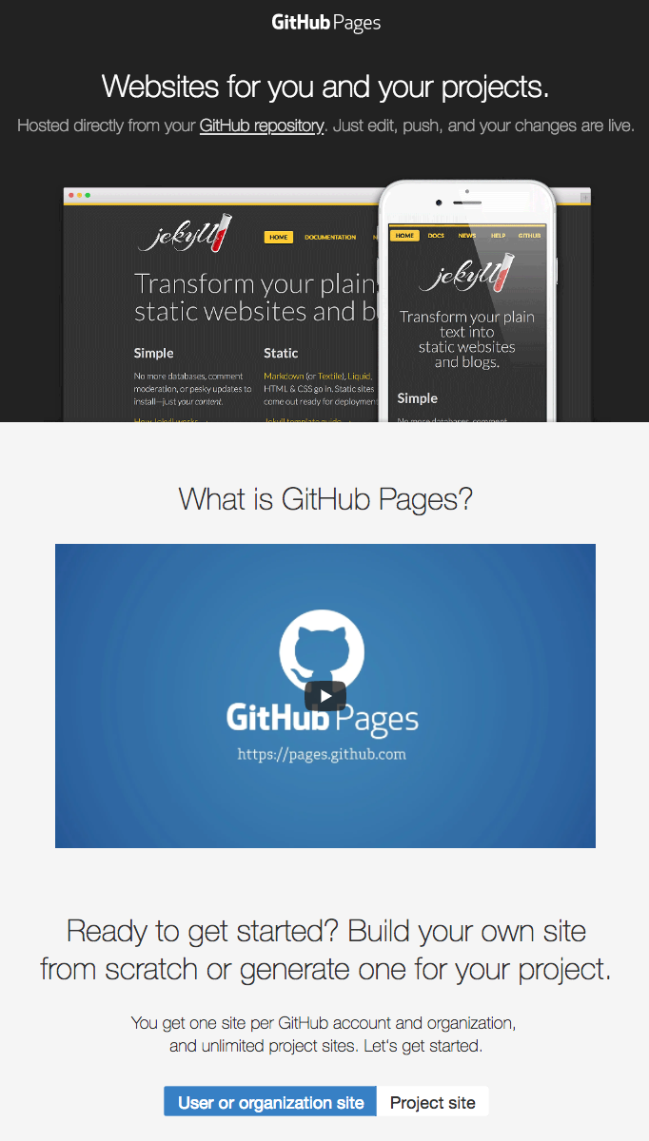
GitHub Pages https://pages.github.com/
Allows you to publish simple websites directly from GitHub
You can generate one site per GitHub account or organization, and unlimited project sites
Great for providing simple documentation or project information without having to worry about web hosting

Slide 51
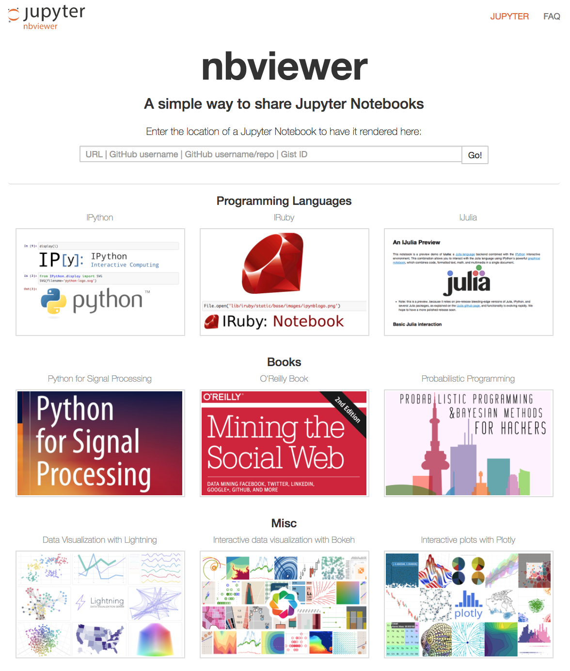
Jupyter NBViewer http://nbviewer.jupyter.org/
Free web service that allows rendering static html versions of publically-available Jupyter Notebooks (all you need is the link!)
Basically reads the json data from your Jupyter Notebook and renders the input and output fields just like your browser
However, there is no kernel running to execute code on the other end like in Jupyter Notebook
Can render notebooks hosted in your (or other people’s) GitHub repos

Slide 52
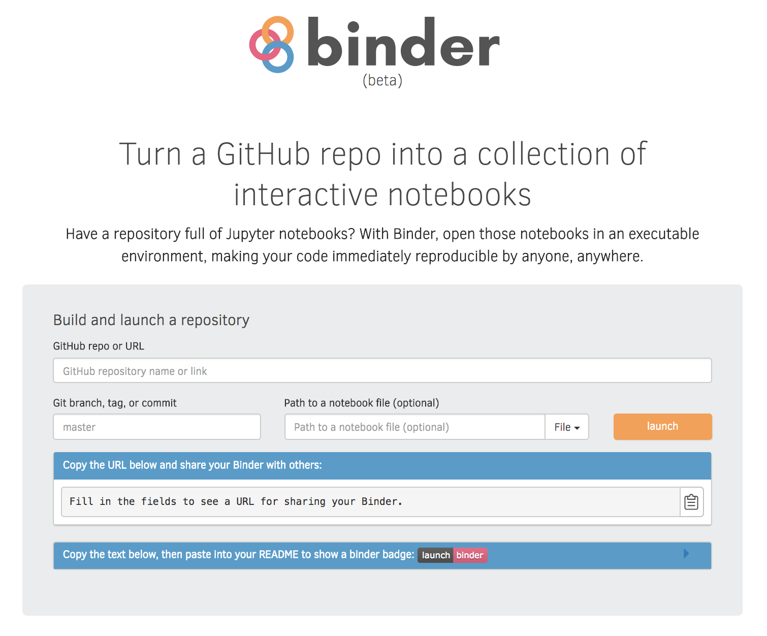
Binder (beta) https://mybinder.org/
Online tool that let’s you build a GitHub repo into a Docker image that can then run interactively online via JupyterHub
Includes a fancy Binder badge for GitHub you can include in your readme

Slide 53
5. Links and Resources
GIT and GITHUB References and documentation

Slide 54
Git DOCUMENTATION
API documentation: https://git-scm.com/docs

Slide 55
GIT CHEATSHEETS
Official GitHub Git cheat sheet: https://services.github.com/on-demand/downloads/github-git-cheat-sheet.pdf
Interactive cheat sheet: http://ndpsoftware.com/git-cheatsheet.html
http://justinhileman.info/article/git-pretty/
https://github.com/hbons/git-cheat-sheet

Slide 56
Git concept visualizations and tutorials
https://www.atlassian.com/git/tutorials
https://learngitbranching.js.org/
https://onlywei.github.io/explain-git-with-d3/

Slide 57
GIT WORKFLOW INFO
GitHub Flow guide: https://guides.github.com/introduction/flow/index.html

Slide 58
Git Commit Messages
“5 Useful Tips for a Better Commit Message”: https://robots.thoughtbot.com/5-useful-tips-for-a-better-commit-message
“A Note About Git Commit Messages”: https://tbaggery.com/2008/04/19/a-note-about-git-commit-messages.html
The imperative style: https://dpb.bitbucket.io/the-imperative-style-in-commits-and-docstrings.html

Slide 59
GITHUB Documentation

Slide 60
Cool GitHub REPO Examples

Slide 61
6. Git Command Reference
A breakdown of key git commands and how they work

